Slide 1
Confusion Metrics

Slide 2
What is Confusion Metrics ?
Confusion metrics, also known as confusion matrices, are a way to evaluate the performance of a classification model by comparing the predicted and actual class labels of a dataset. They provide insights into the model's accuracy and error rates for different classes. Confusion metrics are commonly used in machine learning and are particularly useful when dealing with imbalanced datasets.

Slide 3
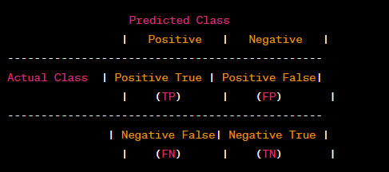
How it Look Like.

Slide 4
Elements of the confusion matrix
True Positives (TP): The number of instances that are correctly predicted as positive (actual positive, predicted positive).
False Positives (FP): The number of instances that are incorrectly predicted as positive (actual negative, predicted positive).
False Negatives (FN): The number of instances that are incorrectly predicted as negative (actual positive, predicted negative).
True Negatives (TN): The number of instances that are correctly predicted as negative (actual negative, predicted negative).

Slide 5
Based on these values, several metrics can be derived to evaluate the model's performance
Accuracy: It is the overall accuracy of the model and is calculated as (TP + TN) / (TP + FP + FN + TN). It represents the proportion of correctly classified instances.
Precision: Precision is the proportion of true positive predictions among all positive predictions and is calculated as TP / (TP + FP). It measures the model's ability to correctly identify positive instances.
Recall (Sensitivity or True Positive Rate): Recall is the proportion of true positive predictions among all actual positive instances and is calculated as TP / (TP + FN). It measures the model's ability to correctly capture positive instances.
Specificity (True Negative Rate): Specificity is the proportion of true negative predictions among all actual negative instances and is calculated as TN / (TN + FP). It measures the model's ability to correctly identify negative instances.
F1 Score: The F1 score is the harmonic mean of precision and recall, and it provides a single metric that balances both precision and recall. It is calculated as 2 * (precision * recall) / (precision + recall).

